Slide 1


FHIR Overview HL7® FHIR® Connectathon22 Sep 14, 2019
Presenter:
Richard Ettema
FHIR® Certified Implementer
Lead Consultant, AEGIS.net, Inc.
richard.ettema@aegis.net
Notes:
Introduction of presenter

Slide 2
Session Goals
Understand the basics of the FHIR specification
Understand how to navigate through the FHIR specification website

Slide 3
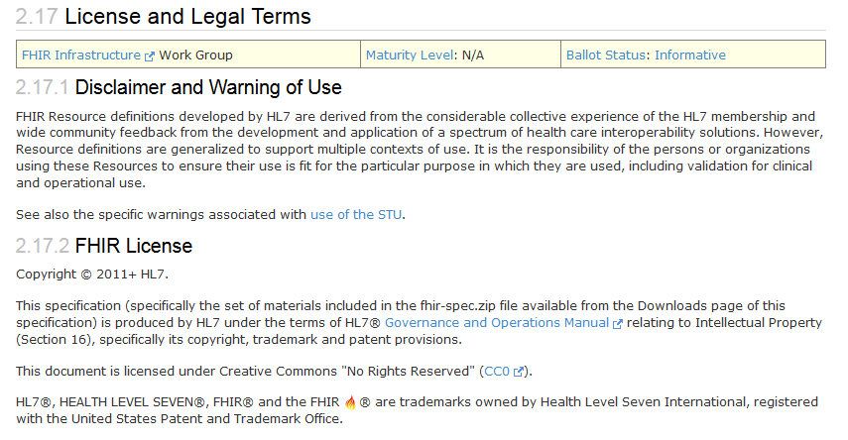
FHIR License & Terms of Use
www.hl7.org/fhir/license.html

Slide 4

What is FHIR?
The Next Generation Standards Framework from HL7
Resources (building blocks)
Extensions (part of the specification)
Methodology (bundles, profiles, conformance)
Syntax: JSON, XML, RDF(Turtle)
Human Readability
FHIR defines a set of modular components called "Resources"
FHIR offers flexibility in implementations; a simple framework to extend and adapt existing “Resources”

Slide 5
The Acronym
F – Fast (to design & to implement)
Relative – No technology can make integration as fast as we’d like
H – Healthcare
That’s why we’re here
I – Interoperable
Ditto
R – Resources
Building blocks – more on these next

Slide 6
It’s All About the Resources . . .
Building blocks…
Location
Related
Person
Patient
Diagnostic
Report
Practitioner

Slide 7

Resources
Defined Structured Data
The logical, common contents of the resource
Mapped to formal definitions; e.g. RIM & other formats
Syntax – XML, JSON and RDF(Turtle)
Logical collections of data elements
Extensions
Local requirements, but everyone can use
Additional data that isn’t part of the original specification
Published and managed
Narrative
Human readable
Notes:
Extensions—pull additional data that wasn’t part of the spec. Extension language is built into format
https://www.w3.org/TR/turtle/ →
The Resource Description Framework (RDF) is a general-purpose language for representing information in the Web.
This document defines a textual syntax for RDF called Turtle that allows an RDF graph to be completely written in a compact and natural text form, with abbreviations for common usage patterns and datatypes. Turtle provides levels of compatibility with the N-Triples [N-TRIPLES] format as well as the triple pattern syntax of the SPARQL W3C Recommendation.

Slide 8
<Patient xmlns="http://hl7.org/fhir">
<id value="example"/>
<meta>
<lastUpdated value="2017-01-14T09:14:33Z"/>
</meta>
<text>
<status value="generated"/>
<div xmlns="http://www.w3.org/1999/xhtml">
<p>Henry Levin the 7th</p>
</div>
</text>
<extension url="http://hl7.org/fhir/StructureDefinition/us-core-birthsex">
<valueCode value="M"/>
</extension>
<identifier>
<use value="usual"/>
<system value="urn:oid:1.2.36.146.595.217.0.1"/>
<value value="12345"/>
</identifier>
<active value="true"/>
<name>
<use value="official"/>
<family value="Levin"/>
<given value="Henry"/>
<suffix value="the 7th"/>
</name>
<gender value="male"/>
<birthDate value="1974-12-25"/>
<managingOrganization>
<reference value="Organization/example"/>
</managingOrganization>
</Patient>
FHIR Id & Metadata
Human Readable Summary
Extension with reference to its definition
Standard Data Content:
Patient Identity
Name
Gender
Date of Birth
Provider

Slide 9
{
"resourceType": "Patient",
"id": "example",
"meta": {
"versionId": "1",
"lastUpdated": "2017-01-03T16:05:00.792Z"
},
"text": {
"status": "generated",
"div": "<div xmlns=\"http://www.w3.org/1999/xhtml\"><p>Henry Levin the 7th</p></div>"
},
"extension": [
{
"url": "http://hl7.org/fhir/StructureDefinition/us-core-birthsex",
"valueCode": "M"
}
],
"identifier": [
{
"use": "usual",
"system": "urn:oid:1.2.36.146.595.217.0.1",
"value": "12345"
}
],
"active": true,
"name": [
{
"use": "official",
"family": "Levin",
"given": [ "Henry“ ],
"suffix": [ "the 7th“ ]
}
],
"gender": "male",
"birthDate": "1974-12-25",
"managingOrganization": {
"reference": "Organization/example"
}
}
FHIR Id & Metadata
Human Readable Summary
Extension with reference to its definition
Standard Data Content:
Patient Identity
Name
Gender
Date of Birth
Provider

Slide 10
What is a Resource?
FHIR Resource Types
Administrative
Patient, Practitioner, Organization, Location, Coverage, Invoice
Clinical Concepts
AllergyIntolerance, Condition, Family History, CarePlan
Infrastructure/Conformance
CapabilityStatement, StructureDefinition
Non-Resource Types
Gender
Too small
Electronic Health Record
Too big
Blood Pressure
Too specific
Intervention
Too broad
Notes:
Instructor Notes: The two starred items will be touched on more later as the session covers key elements in the FHIR specification

Slide 11
CapabilityStatement
A resource for documenting the capabilities of a FHIR client and server.
A client should examine the CapabilityStatement of a server to determine the supported behavior of the server.
The CapabilityStatement:
is a key part of the FHIR conformance framework
is a statement of the features, rules and behaviors of a FHIR system
may be used for system compatibility testing, code generation, or as the basis for conformance testing
To declare themselves “FHIR Conformant”, a system must publish a CapabilityStatement:
http://hl7.org/fhir/STU3/http.html#capabilities
Notes:
Instructor will mention importance of capability statement to FHIR testing
Capability Statement—think of it more on the server side

Slide 12
StructureDefinition
A resource that describes a structured set of data element definitions and their associated rules of usage
how resource elements and/or data types are used or not used
resource or data type extensions
Value Set references that specify the content of coded elements
Describes the content defined in the specification
Describes (Profiles) HOW these structures are utilized in implementations

Slide 13

Scenario
Example: A mother takes her child to Sunset Pediatric Office. The pediatrician needs to determine what vaccination shot(s) are due for the child.
What FHIR resources will be used to record this visit and forecast the shot(s) that are due?

Slide 14

Answers
Recording the visit
Patient
Practitioner
Organization
Location
Observation
Encounter
Others?
Forecasting the shots
Patient
Immunization
Immunization Recommendation
Let’s see how this would work…

Slide 15


Immunization Forecast Workflow
Sunset Pediatric Office
Forecast Request
(patient & immunization(s))
Regional Immunization Forecast Service
Forecast Response (recommendations)
Notes:
Spent some time on forecast service due to questions.

Slide 16
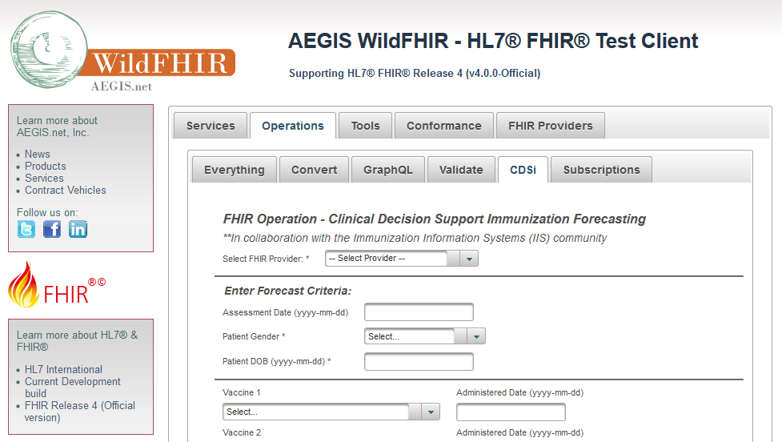
WildFHIR Demo – Immunization Forecast
http://wildfhir4.aegis.net/fhir4-0-0-gui/index.jsf

Slide 17
FHIR Defines Testing
To ensure interoperability between applications claiming conformance to the specification, a testing framework has been established within the FHIR specification itself
https://www.hl7.org/fhir/STU3/testing.html
This framework defines the TestScript resource as a natural language, computable format of a test case
The TestScript resource represents an executable test definition for examining the results of FHIR RESTful API interactions
https://www.hl7.org/fhir/STU3/testscript.html
Notes:
Touching on the Testing/TestScript concept. A deeper dive into these topic later, but introducing it now.

Slide 18
A FHIR Test Engine
The FHIR TestScript defines the test but how do we run it? – A FHIR Test Engine
What does a FHIR Test Engine need to be capable of doing?
Pre-Processing
Setup Execution
Test Execution
Tear-Down Execution
Post-Processing
AEGIS has built such an engine so that others can subscribe to it for testing without having to carry the overhead and expense of setting up their own

Slide 19
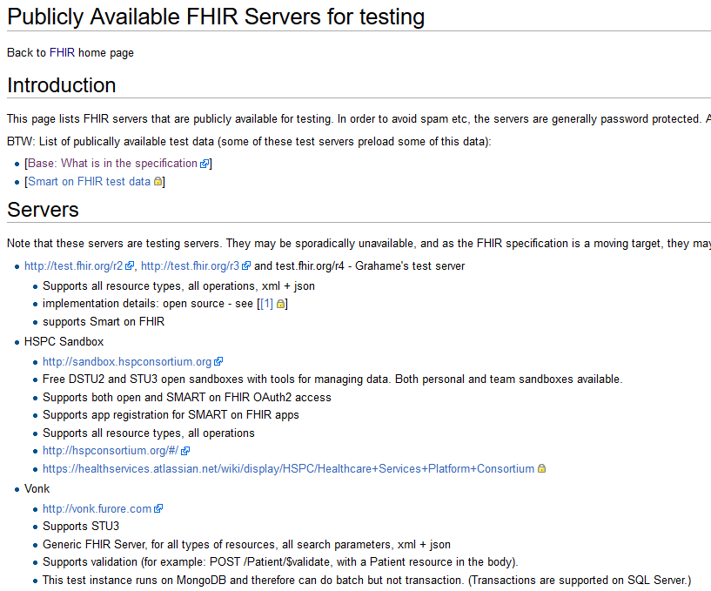
Public FHIR Servers for Testing http://wiki.hl7.org/index.php?title=Publicly_Available_FHIR_Servers_for_testing
More than two dozen publicly available test servers (and clients)
Support for multiple versions:
Release 2 (DSTU2)
Release 3 (STU3)
Release 4 (R4)
Current CI
Maintained and supported by the FHIR community
More than a dozen publicly available test servers (and clients)
Support for multiple FHIR versions (DSTU2, STU3, and current CI)
Maintained and supported by the FHIR community
More than a dozen publicly available test servers (and clients)
Support for multiple FHIR versions (DSTU2, STU3, and current CI)
Maintained and supported by the FHIR community
More than a dozen publicly available test servers (and clients)
Support for multiple FHIR versions (DSTU2, STU3, and current CI)
Maintained and supported by the FHIR community
Notes:
To see the capabilities of these test servers, get the capability statement.

Slide 20
Paradigms
FHIR supports four interoperability paradigms
REST
Documents
Messages
Services

Slide 21
REST
Simple, out-of-the-box interoperability
Leverages HTTP: GET, POST, etc.
Pre-defined operations
Create, Read, Update, Delete
Also: History, Read Version, Search, Updates, Validate, Capabilities, Batch & Transaction
Works best where control resides on client side and a trust relationship exists
REST
Notes:
URLs, parameters, etc. all defined
Choice of what operations to support
Behavior documented in conformance profile – mandatory
Use it to extend URL

Slide 22
Documents
Documents
Similar to CDA
A collection of resources bound together
Root is a “Composition” resource
Just like CDA header
Sent as a Bundle (FHIR Resource)
Single context
Can be signed, authenticated, etc.

Slide 23
Messages
Similar to v2 and v3 messaging
Also a collection of resources
Sent as a Bundle (FHIR Resource)
Allows request/response behavior for both request and response payloads
Event-driven
e.g. Send lab order, get back result
Can be asynchronous
Messages

Slide 24
Services
Combination of previous paradigms
Based on Service Oriented Architecture (SOA) principles
Ultra complex workflows
Ultra simple workflows
Individual resources or collections (in Bundle, contained resources or other formats)
Use HTTP or use something else
Only constraint is that you’re passing around FHIR resources in some way, shape, manner or form
Services

Slide 25
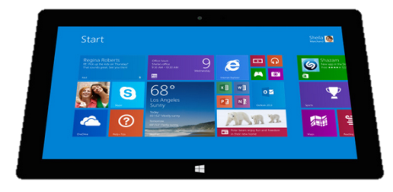
Regardless of the paradigm the content is the same
Receive a lab result in a message…
FHIR
Repository
FHIR Message
FHIR Document
Lab System
REST
National
Exchange
…Package it in a discharge summary document

Slide 26
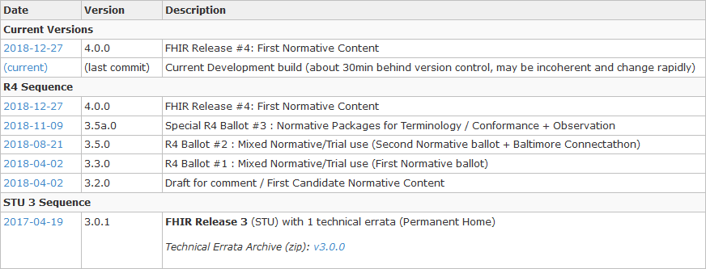
FHIR Specification
Directory to all FHIR versions: http://hl7.org/fhir/directory.html

Slide 27
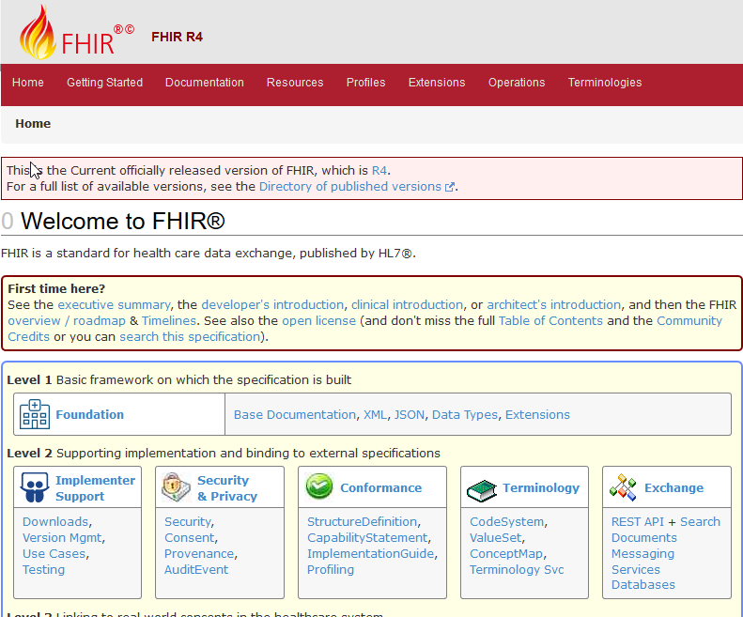
Welcome to FHIR
Notes:
Presenter can stop presentation to give tour of FHIR website
Suggested listing for site tour:
1.) Point out the ‘first time here’ section
2.) Click on Foundation and talk to the Common Use Cases: Exchanging Data section, drill down to the RESTful API section and scroll down through the available content
3.) Still in Foundation, talk to the Data Types definition – click on that and show them around
4.) Click on the Resources – show listing and groupings, select Patient. Talk to the Resource Content, but also, show the other Header Tabs (Examples, Profiles & Extensions, etc.) as those will be very useful when they are on their own

Slide 28
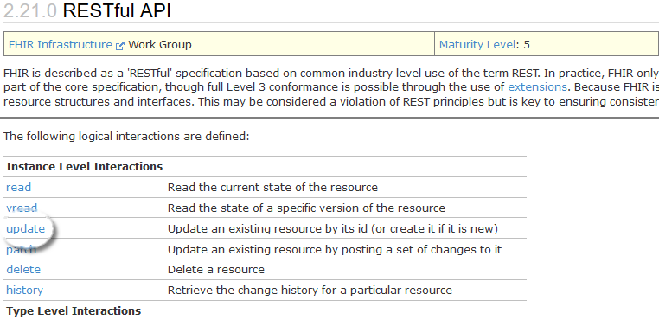
RESTful API http://hl7.org/fhir/http.html
The Instance Level, Type Level and Whole System Interactions are listed at the top of the page.
Clicking on any specific interaction will display the details of that interaction; e.g. update will show all of the FHIR requirements for updating resources.

Slide 29
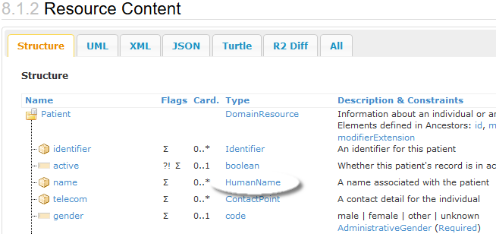
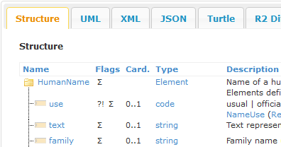
Patient Resource Content http://hl7.org/fhir/patient.html#resource
The Structure tab shows how the resource type elements are organized
The Card. stands for cardinality, and shows the minimum and maximum number of times an element can appear in an instance.
The Type lists the FHIR data type of the elements; e.g. name is of type HumanName. Clicking on HumanName will show its structure.
Notes:
Discuss all the header tabs and the other information available in the specification, in addition to Structure and Content.

Slide 30
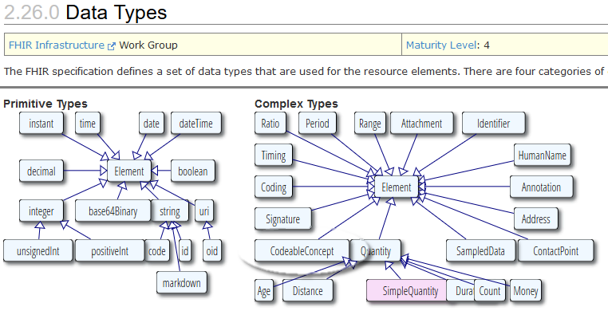
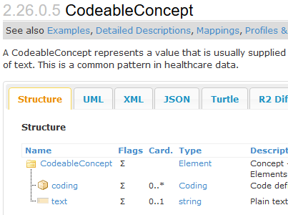
Data Types http://hl7.org/fhir/datatypes.html
The Primitive and Complex Types are displayed at the top of the page.
Clicking on any specific data type will display the details of that type; e.g. CodeableConcept will show the structure of that data type.
Notes:
Lower case—primitive
Upper case—complex type

Slide 31
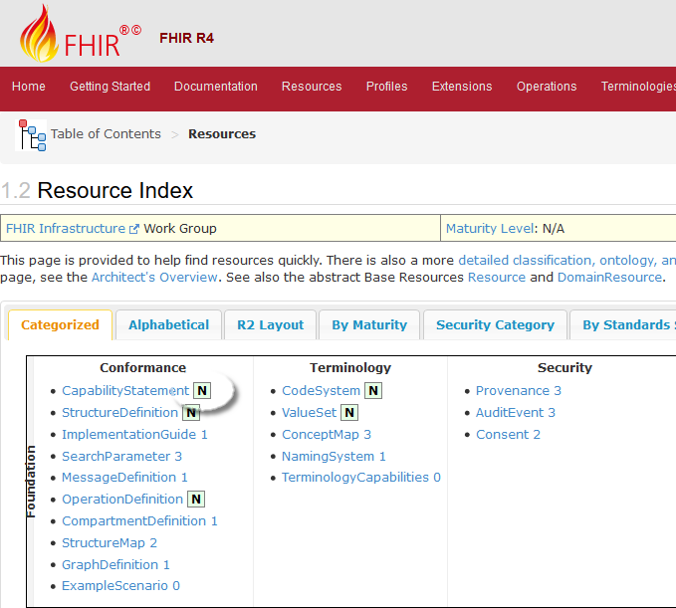
FHIR Maturity Model http://hl7.org/fhir/versions.html#maturity
0: Draft
1: + No build warnings
2: + Successfully exchanged/tested between 3 systems (Connectathon)
3: + Verified by WG; formally balloted
4: + Scope tested; formal publication; multiple project
5: + Published 2+ release cycles; 5+ independent production deployments
N: Normative

Slide 32
Recap: What Does FHIR provide?
Resources (Building Blocks)
Extensions (Part of the Spec)
Methodology
Bundles, Profiles, Conformance
Syntax: XML, JSON, RDF(Turtle)
Human Readability
CapabilityStatement, StructureDefinition, Testing Framework
Support for Multiple Paradigms
REST, Messaging, Documents, Services
Extensive online documentation

Slide 33
FHIR Timeline
FHIR R4 contains the first normative content released December 2018.
First Draft
DSTU
1.0
DSTU
2.0
STU
3.0
R4
1st Norm
R5
??
2011
2012
2013
2014
2015
2016
2017
2018
2019
2020

Slide 34

Discussion (Q & A)
Notes:
CBH – try to keep Q&A to 5 mins. Additional discussion can be held at breaks, lunch, or after class. Also keep in mind that some of the questions may be answered in later sessions.

